Slide 1
Tapes In Surveying

Slide 2
Types of Tapes Used in Surveying
Tapes are used in surveying to take linear measurements. They are available in different lengths and can be made of different materials. The most common types of tapes used in surveying are:
CLOTH OR LINEN TAPE
METALLIC TAPE
STEEL TAPE
INVAR TAPE

Slide 3
CLOTH OR LINEN TAPE:
Cloth tapes are made up of closely woven linen, 12 to 15 mm wide. These tapes are varnished on outer surface so as to resist moisture. Cloth tapes are light and flexible.
Cloth tapes are used for taking rough measurements such as offsets. Cloth tapes are available in lengths of 10, 20, 25, and 30 meters and in 33, 50, 66, 100 ft.. End of the tape is provided with a brass ring whose length is included in the total length of the tape.
Cloth tapes are not used for accurate measurements because: 1)Length of cloth tape is gets altered by stretching. 2)Cloth tape is easy to twist and tangle. 3)Cloth tapes are not so strong

Slide 4
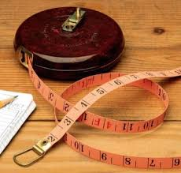
CLOTH OR LINEN TAPE

Slide 5
METALLIC TAPE:
A metallic tape is made of varnished strip of water proof linen interwoven with small brass, copper or bronze wires. Due to this tape does not stretch easily as a cloth tape.
Metallic tapes are light in weight and flexible and are not easily broken. Metallic tapes are particularly useful in cross-sectioning and in some methods of topographical surveys where small errors in length of the tape are not given importance.
Metallic tapes are manufactured in lengths of 2, 5, 10, 20, 30 and 50 meters. Tapes of lengths 10, 20, 30 & 50 meter are provided with a metal ring at outer end

Slide 6
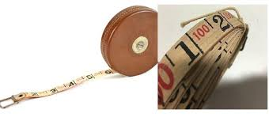
METALLIC TAPE

Slide 7
STEEL TAPE:
A steel tape consists of a light strip of width 6 to 10 mm and is more accurately graduated as compared to cloth and metal tape. Steel tapes are available in lengths of 1, 2, 10, 20, 30 and 50 metres.
The tapes of lengths 10, 20, 30 & 50 metres are provided with a brass ring at outer end, fastened to it by a metal strip of the same width of the tape. The length of the tape is included in metal ring.
Steel tapes vary in quality and in accuracy of graduation, but even a poor steel tape is generally more useful and accurate as compared to cloth or metallic tape.Steel tapes are wound on a corrosion resisting metal case with winding device.Steel tape is a delicate and light weight instrument hence it cannot withstand rough usage

Slide 8
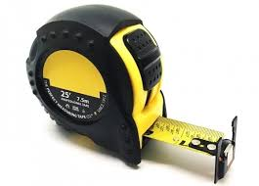
STEEL TAPE

Slide 9
INVAR TAPE:
Invar tapes are available in lengths of 20, 30 and 100 meters. Invar tapes are used whey high degree of accuracy and precision in linear measurements is required such as measurement of base lines.
Invar tapes are made of alloys of nickel and steel and have very low coefficient of thermal expansion. Invar tapes are more expensive as compared to other tapes.
Main disadvantage of this tape is that it’s length and coefficient of thermal expansion is not constant. It keeps changing with time. Therefore it is suggested to determine the length and coefficient of thermal expansion time to time.

Slide 10
INVAR TAPE

